Slide 1
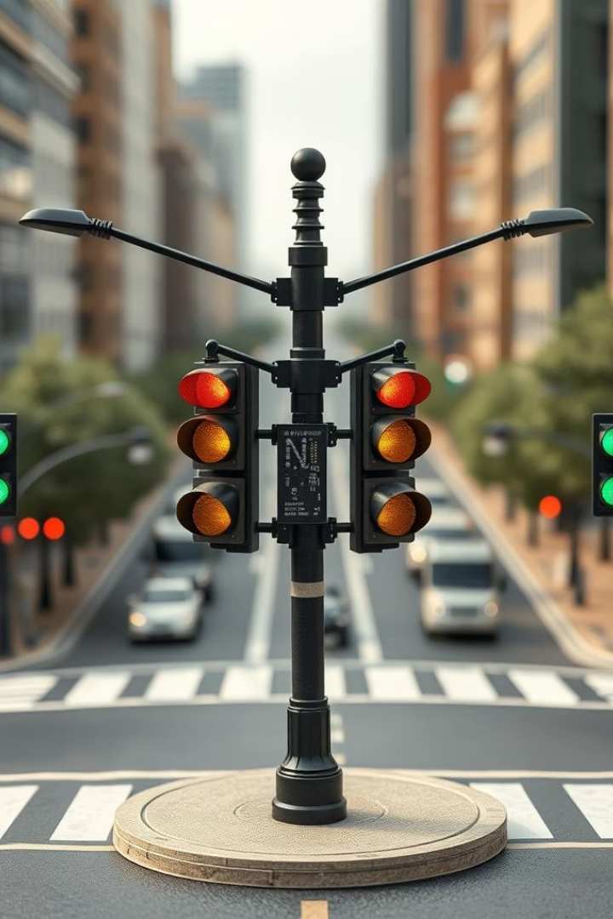
TRAFFIC LIGHT CONTROLLER WITH SENSOR​
Mehmet Yusuf Ocak & Mehmet Yasin Uzun

Slide 2
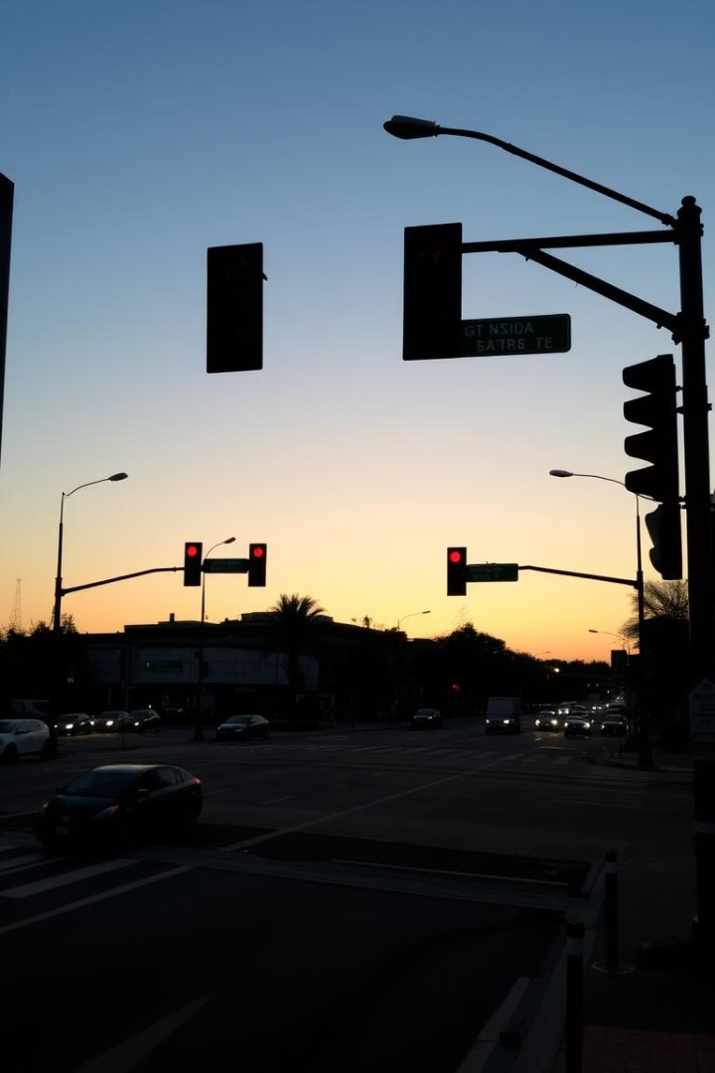
Traffic Light Control System with Discrete Digital Logic
This presentation part explores the design and implementation of a two-way traffic light control system using discrete digital logic components. The focus is on how D-type flip-flops are utilized to build a shift register-based Finite State Machine (FSM) that manages traffic flow. The system is tailored to regulate traffic at a bi-directional intersection, ensuring safe and efficient operation.
We will delve into the components, logic design, sensor integration, and timing mechanisms that drive this system, aiming to provide a practical and educational overview.

Slide 3
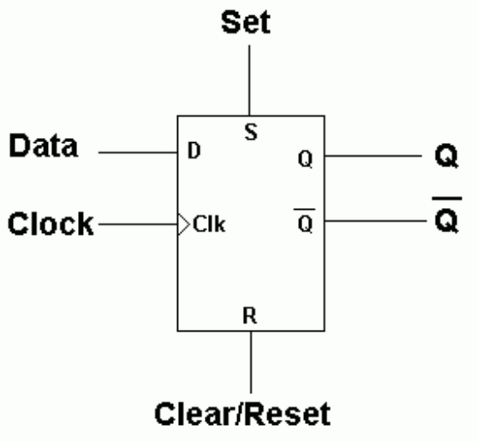
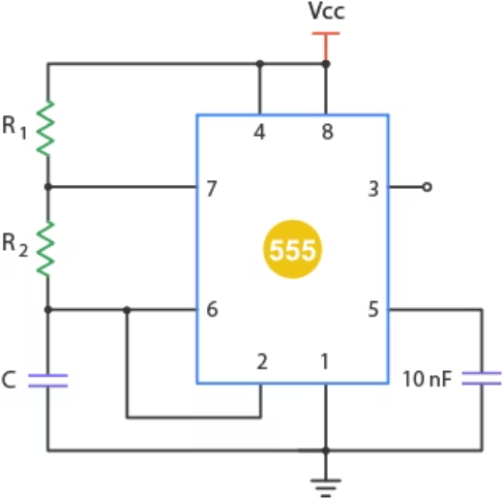
4013 D flip flop & 555 timer
4013 D flip flop
555 timer
Used to store binary states in the FSM. It changes output only on the clock edge, ensuring stable state transitions.
Configured in astable mode to generate a continuous square wave clock signal for driving the FSM.

Slide 4
System Overview: Two-Way Intersection
Traffic Flow Management
Traffic Light Sequence
Sensors and Feedback
The system controls the traffic flow at a two-way intersection, alternating light signals to coordinate vehicles safely across crossings.
Lights cycle through Red, Yellow, and Green to regulate stop and go commands for each direction.
A side road sensor controls the lights. If inactive, main road stays green and side road red. If active, lights change to allow side road traffic.

Slide 5
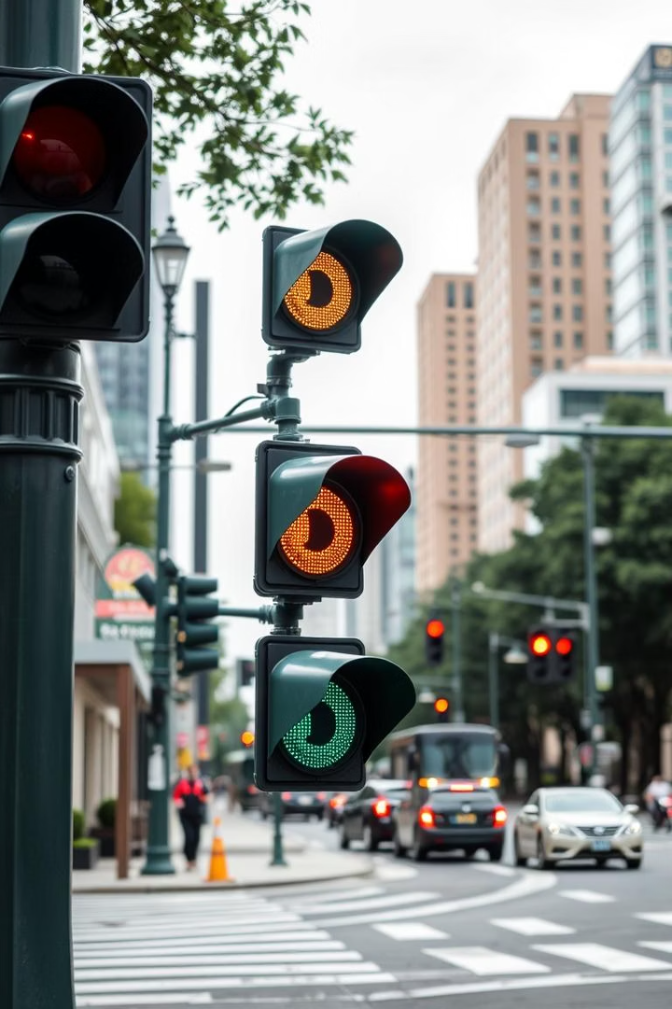



Finite State Machine (FSM) Design
State Definitions
Each state defines a specific traffic light configuration. For example, when the main road light is green, the side road remains red. Other states include main road yellow, side road green, and side road yellow.
State Transitions
Transitions between these states are controlled by the 555 timer outputs and the side road sensor input. If the sensor is inactive, the system stays in the main road green state. If the sensor is active, the FSM proceeds through the full sequence.
Control Logic
The logic ensures that only one road has a green light at a time. This prevents collisions by allowing mutually exclusive light states and correct timing between transitions.

Slide 6
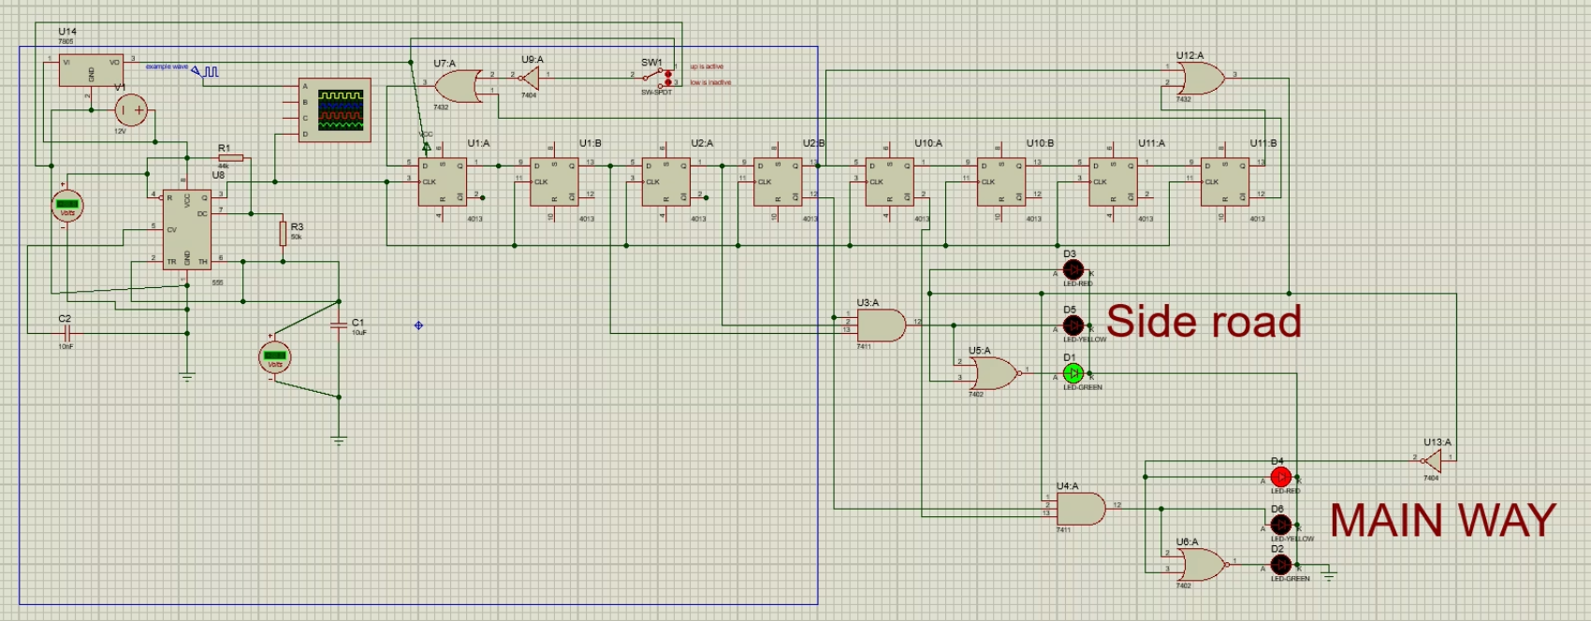
Traffic Light Control System Simulation in Proteus

Slide 7
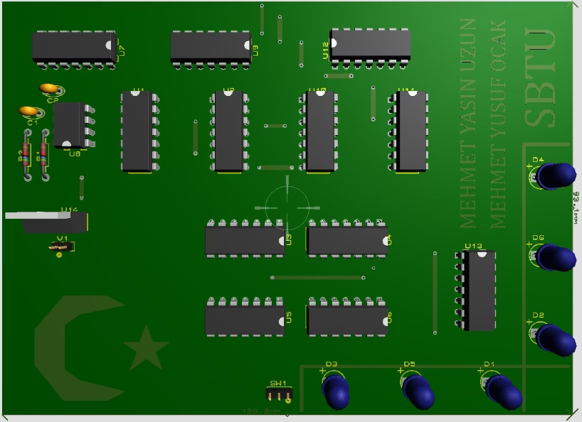
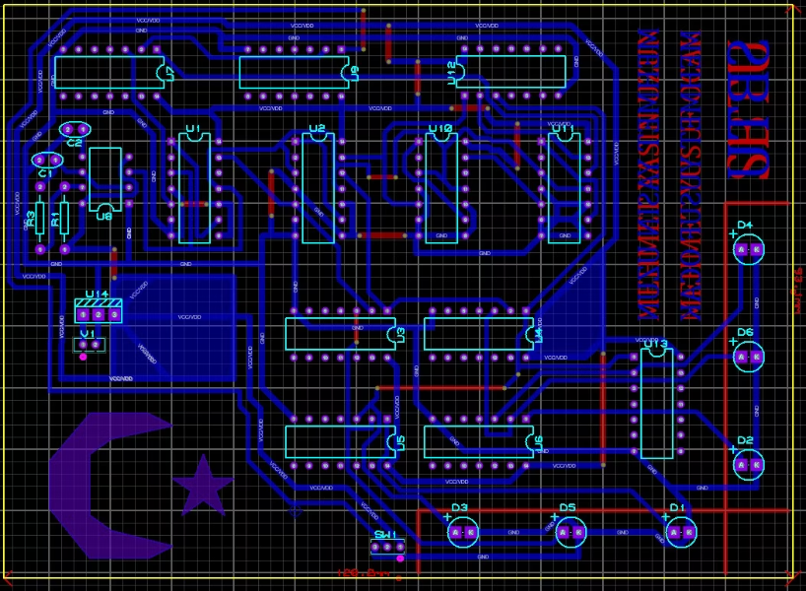
PCB PART
PCB 3D Visualizer
PCB Layout

Slide 8
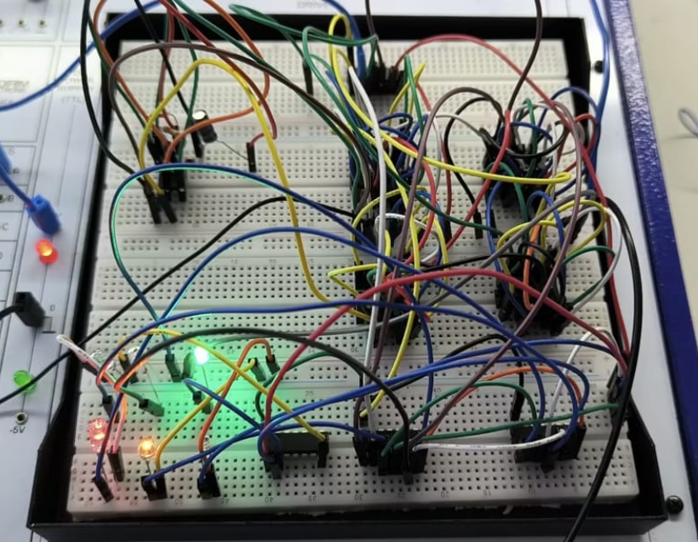
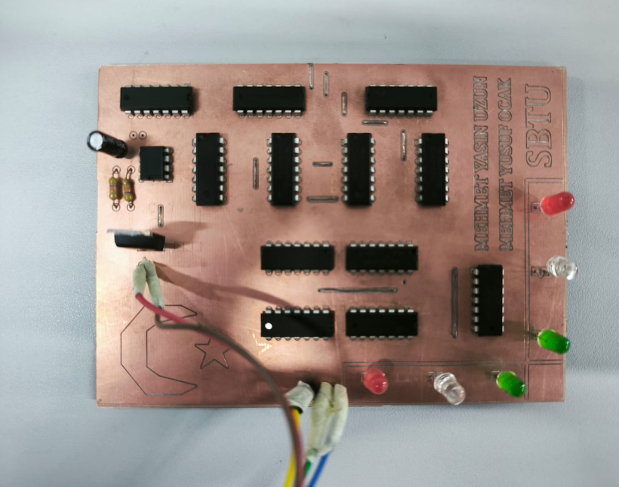
Physical Implementation: Breadboard and PCB
Breadboard
PCB

Slide 9
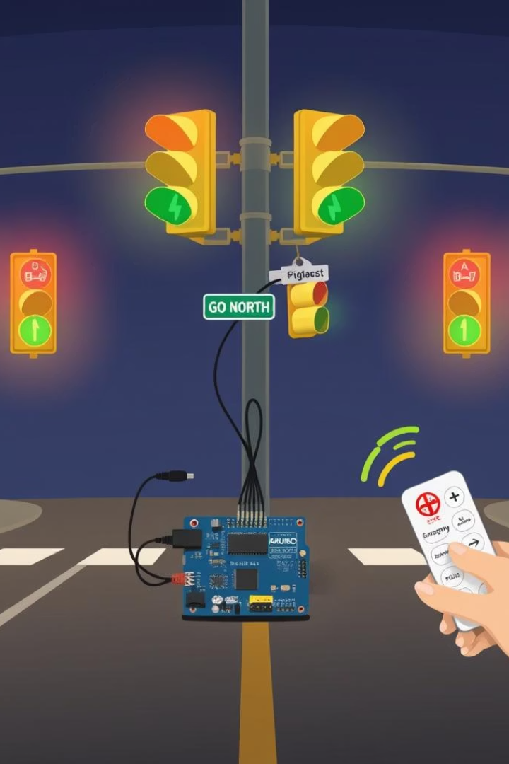
Traffic Light Control System with MicroProcesser
In this project, a four-way traffic light system is implemented using Arduino Uno. A remote control allows manual override during emergency situations. When buttons 8, 4, 2, or 6 are pressed, the corresponding direction (North, West, South, or East) immediately turns green, while all other directions switch to red. This simulates real-world scenarios such as allowing an ambulance or police vehicle to pass safely. Pressing button 5 returns the system back to its normal state machine operation.

Slide 10
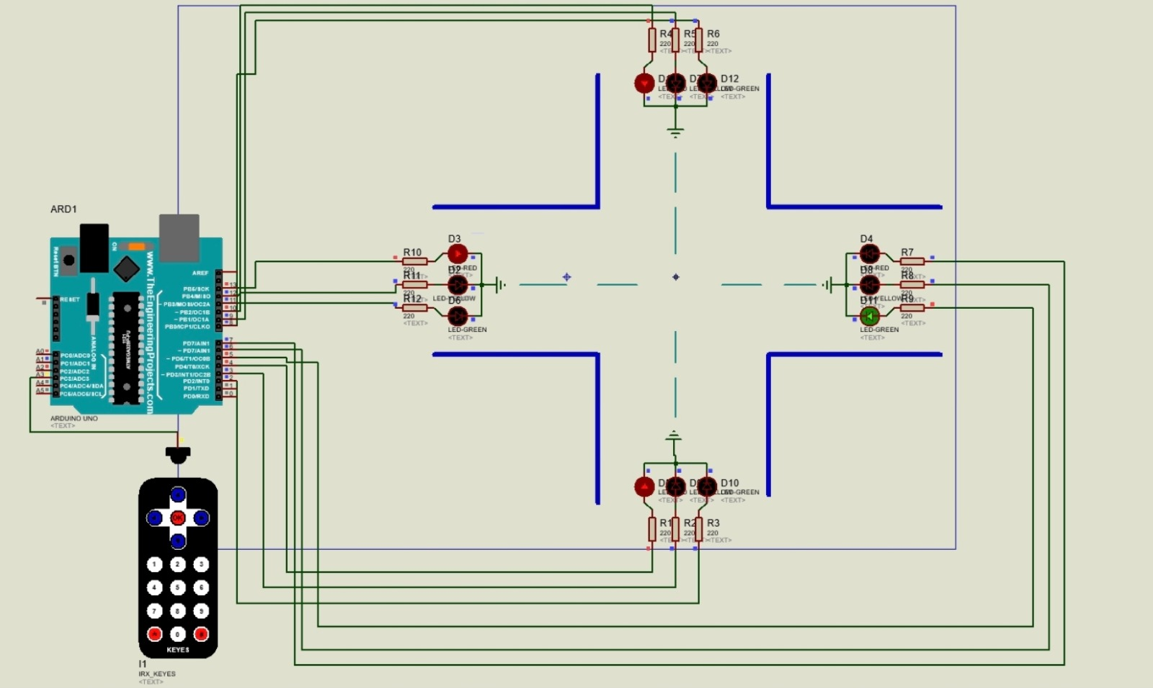
Traffic Light Control System Simulation in Proteus

Slide 11
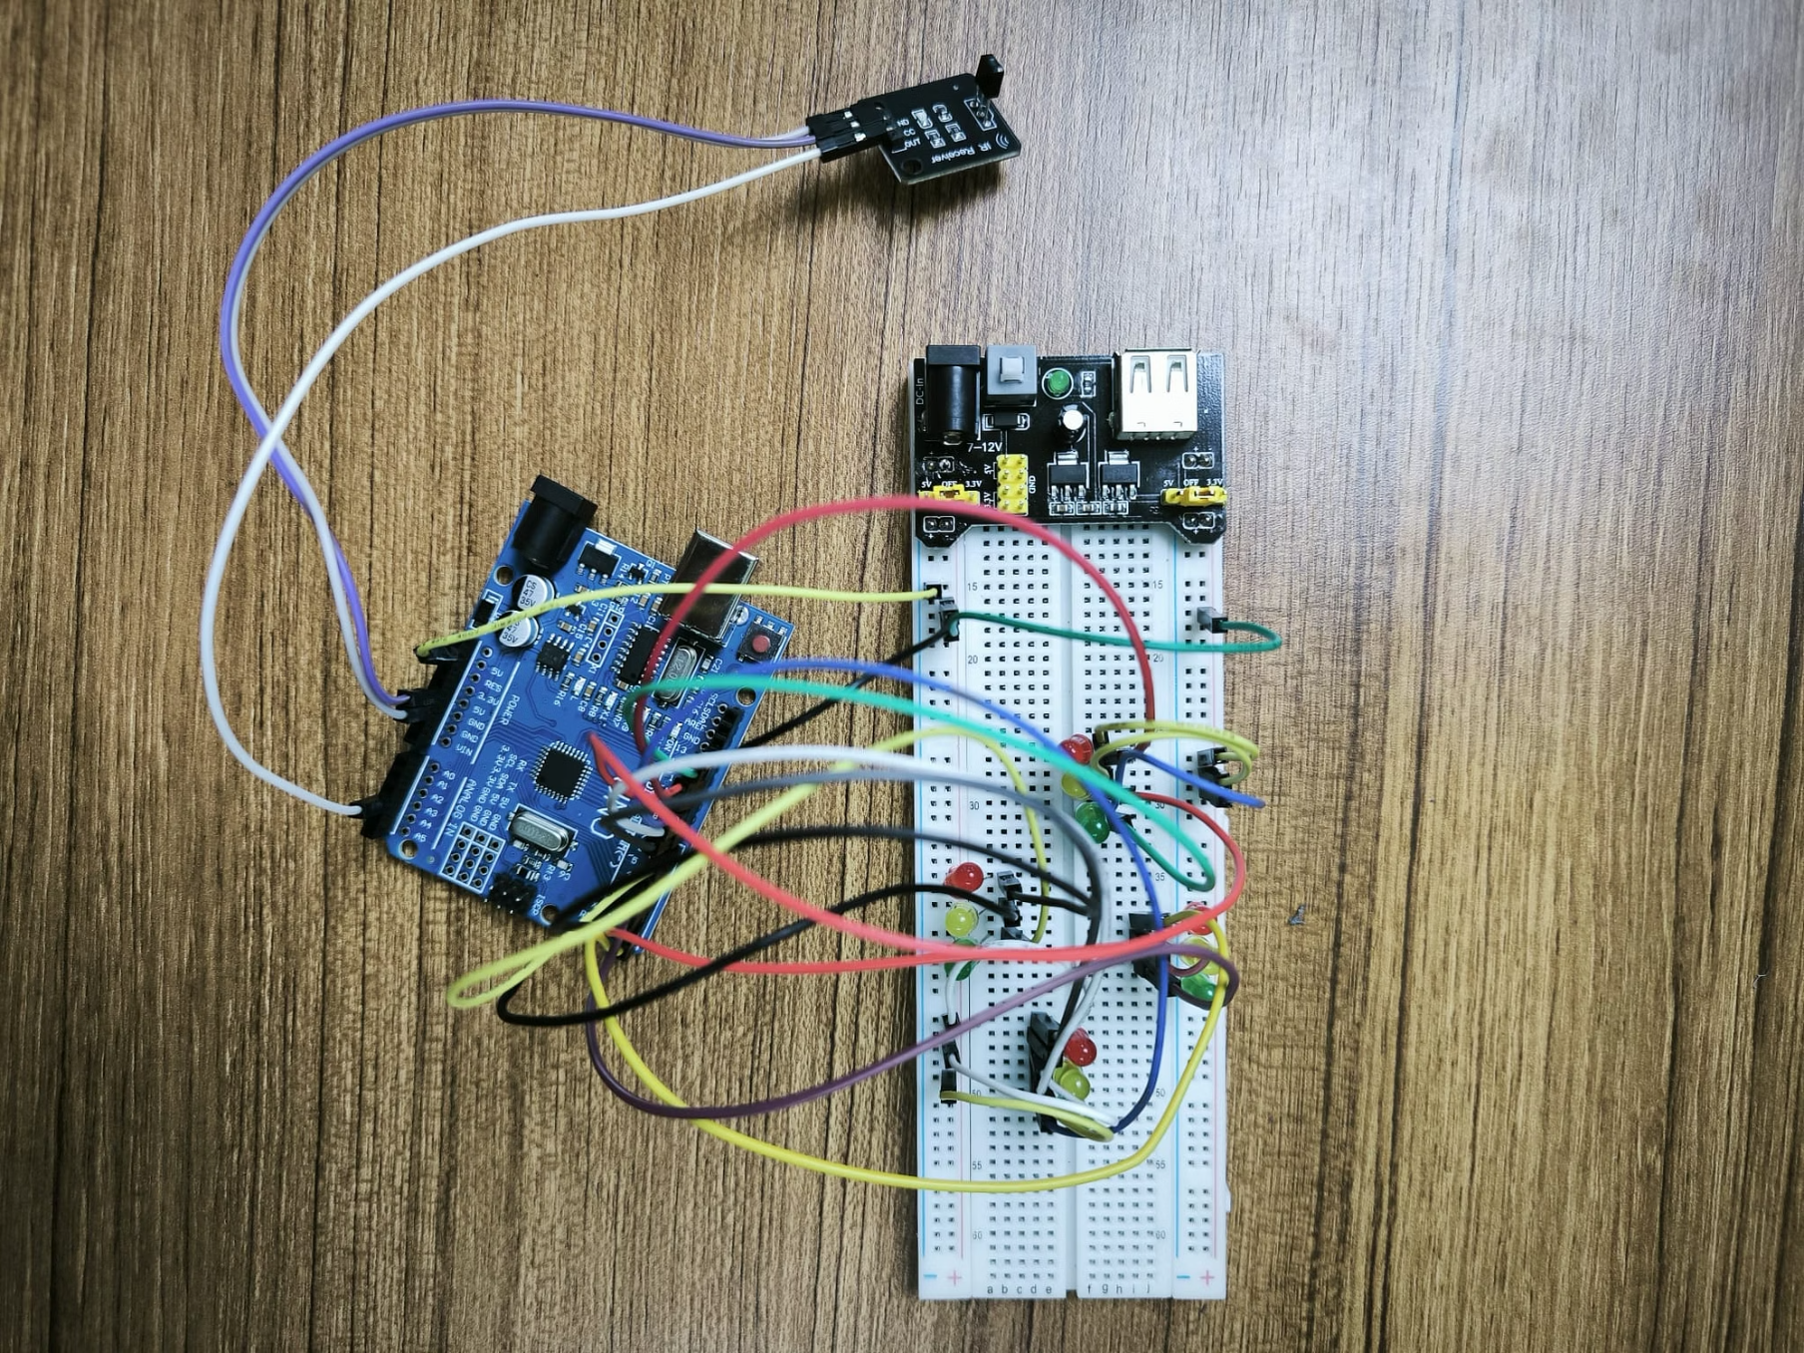
Physical Implementation: Breadboard

Slide 12

Thank You
We appreciate your attention and interest in our Traffic Light Control System project.
We hope you gained valuable insights into its design and implementation.

Slide 13
REFERANCE
https://archive.org/details/DigitalDesign5thEditionByManoCiletti
https://archive.org/details/IC555Projects
https://www.electronics-tutorials.ws/waveforms/555_timer.html
https://www.instructables.com/Arduino-Traffic-Light/
https://archive.org/details/getting-started-with-arduino
https://www.electronicwings.com/note/traffic-light-control-system-using-proteus

